Slide 1
Research Designs for Observational Data: Regression Discontinuity (RD) & Instrumental Variables (IV)
Matt Goldman

Slide 2
Research Design: Regression Discontinuity

Slide 3
Discontinuity
An arbitrary change in treatment assignment that happens at a specific threshold.
We’re interested in the ones that make very similar people get very dissimilar treatment.

Slide 4
Discontinuity Examples: Incumbency Advantage
U.S. House Elections
If you’re first past the pole in the previous election, even by just one vote, you get elected
What can we learn from this?
Incumbency advantage for reelection.
(David Lee, Journal of Econometrics 2007)

Slide 5
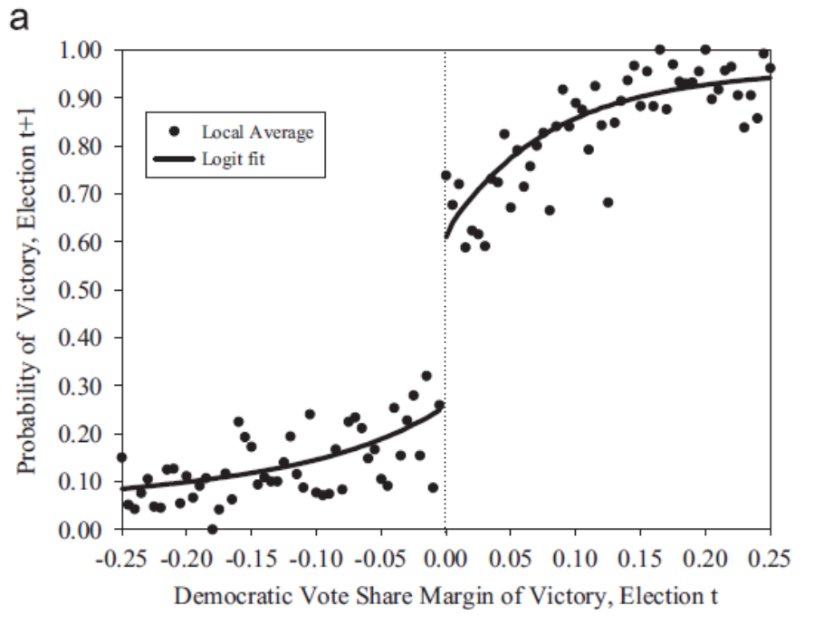
Discontinuity Examples: Incumbency Advantage
Question: All else equal, does winning one political election help you win the next election? (Incumbency effect)
Bad Answer (OLS): Compare the average performance of winners and losers.
Problem: Winning the first election is not random. Is likely to be correlated with characteristics of local electorate. In this case, estimate of effect is biased up.

Slide 6
Regression Discontinuity (RD)
Question: All else equal, does winning one political election help you win the next election? (Incumbency effect)
Best Solution: Compare elections where the Democrats get ~49.9% of vote to elections where they get ~50.1%.
NOTE: This approach is only possible because treatment (winning the first election) is assigned based on a threshold.
Polynomial trends on each side of discontinuity mitigate bias.

Slide 7
Discontinuity Examples: PSAT
PSAT/NMSQT
Basically the top 16,000 test-takers get a scholarship.
A small difference in test score can means a discontinuous jump in scholarship amount.
What can we learn from this?
Wage returns to scholarships/education
Notes:
Supposed to be by Thistlewaite, but I can’t find the reference

Slide 8
Discontinuity Examples: Class Size
School Class Size
Maimonides’ Rule--No more than 40 kids in a class in Israel.
40 kids in school means 40 kids per class. 41 kids means two classes with 20 and 21.
What can we learn from this?
Impact of class size on test scores/performance
(Angrist & Lavy, QJE 1999)

Slide 9
Discontinuity Examples: Impact of Unionization
Union Elections
If employers want to unionize, NLRB holds election. 50% means the employer doesn’t have to recognize the union, and 50% + 1 means the employer is required to “bargain in good faith” with the union.
What can we learn from this?
Impact of unionization on wages/employment/firm closure…
(DiNardo & Lee, QJE 2004)

Slide 10
A Bandwidth of Randomness
Election outcomes aren’t random so incumbency is never randomly assigned
But is a district that voted 50.1% for a democrat that different from one that voted 49.9% for a democrat?
Probably not. Right around the cutoff, there’s a good chance things are random.
However, picking the right window size around the cutoff is difficult. You should try to pick it so that you can make a “convincing picture”.

Slide 11
Implementing a Regression Discontinuity: Definitions
Y: outcome
r: running variable
c: cutoff
T: treatment

Slide 12
Implementing a Regression Discontinuity: Definitions
Y: outcome
r: running variable
c: cutoff
T: treatment

Slide 13
Implementing a Regression Discontinuity: Definitions
Y: outcome
r: running variable
c: cutoff
T: treatment

Slide 14
Implementing a Regression Discontinuity: Definitions
Y: outcome
r: running variable
c: cutoff
T: treatment

Slide 15
Implementing a Regression Discontinuity: Definitions
Y: outcome
r: running variable
c: cutoff
T: treatment
T=1 if (r>c)

Slide 16
Implementing a Regression Discontinuity: Method
Select a subset of data around the discontinuity (c). I.E. |r-c|<h for some “reasonable value of h”.
Regressors:
1: Constant
(r>c): Treatment
1{r>c}*(r-c): linear trend above treatment
1{r<c}*(r-c): linear trend below treatment
Can also include (if it improves fit):
1{r>c}*(r-c)^2, 1{r>c}*(r-c)^3: cubic trend above treatment
1{r<c}*(r-c)^2, 1{r<c}*(r-c)^3 : cubic trend below treatment

Slide 17
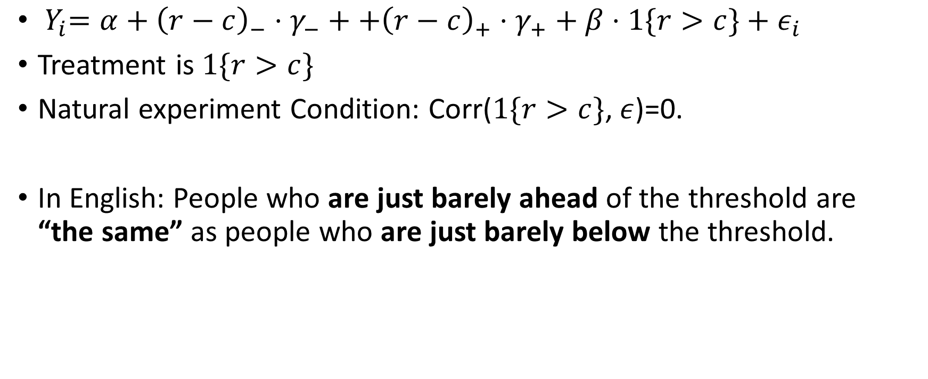
Implementing a Regression Discontinuity: Key Assumption
${ Y}_{i}=α+{\left(r−c\right)}_{−}⋅γ_{−}++{\left(r−c\right)}_{+}⋅γ_{+}+β⋅1\{r>c\}+ε_{i}$
Treatment is $1\{r>c\}$
Natural experiment Condition: Corr($1\{r>c\}$, $ε$)=0.
In English: People who are just barely ahead of the threshold are “the same” as people who are just barely below the threshold.

Slide 18
Can an RD go wrong?
Yes. There are two common ways:
(1) Poor fit of trend line on either side of the discontinuity.
This can usually be fixed by being careful with the modeling.
(2) Subjects “targeting” the threshold.
This will invalidate the entire design.

Slide 19
Poor fit of trend Lines
This picture looks good: the trend line is going through the middle of the dots at the discontinuity; the difference in the trend lines is a good estimate of the effect!
But what if, I forced the lines to be linear on each side of the trend.
Poor fit creates bias in treatment effect!
Two possible solutions:

Slide 20
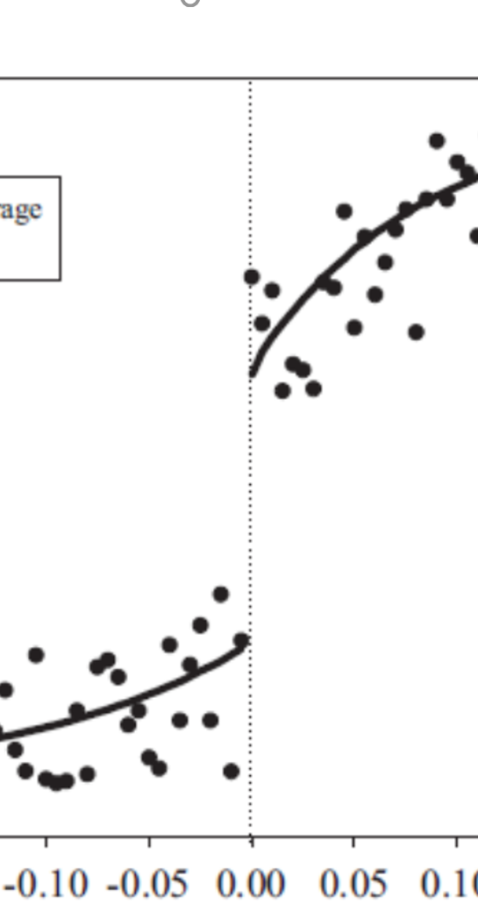
Poor fit of trend Lines
This picture looks good: the trend line is going through the middle of the dots at the discontinuity; the difference in the trend lines is a good estimate of the effect!
But what if, I forced the lines to be linear on each side of the trend.
Poor fit creates bias in treatment effect!
Two possible solutions:
Shrink window of data used around cutoff so that linear is a better fit.

Slide 21
Poor fit of trend Lines
This picture looks good: the trend line is going through the middle of the dots at the discontinuity; the difference in the trend lines is a good estimate of the effect!
But what if, I forced the lines to be linear on each side of the trend.
Poor fit creates bias in treatment effect!
Two possible solutions:
Shrink window of data used around cutoff so that linear is a better fit.
Use a higher order polynomial.

Slide 22
General Principles for Good Fitting Trend Lines
(1) If you increase the window around the threshold, you may want to also increase the degree of the polynomial.
(2) Always look at your “picture” and make sure it makes sense.

Slide 23
A “Targeting” Prone RD
Suppose I offer a college scholarship to anyone who does more than 400 hours of community service. Is that a valid discontinuity?
What do we think about someone who does 399 hours of community service. Are they the same as someone who does 401 hours?
Probably not.

Slide 24
“Targeting” Breaks an RD
If agents have the ability to target their effort to get on either side of the discontinuity, then the discontinuity may not be a true “natural experiment”.
Is this testable? Not exactly, but somethings you can check. For example if there is a discontinuity in the histogram of the “forcing variable” at the cut-off, it indicates that agents may be targeting.

Slide 25
Testing for “Targeting”: RD on other outcomes
Do other characteristics change discontinuously around the threshold? If so, this suggests crossing the threshold is not random.
Suppose 50.1% (Democratic) districts were statistically more likely to be in Alabama. Suppose 50.1% (Republican) districts were often in Alabama.
This would be very suspicious and would invalidate the RD (and possibly also the elections!)
Easy test to implement: Just re-run your RD and use a different outcome variable (in this case a dummy variable for Illinois). If you get a statically significant result, then you are in trouble!

Slide 26
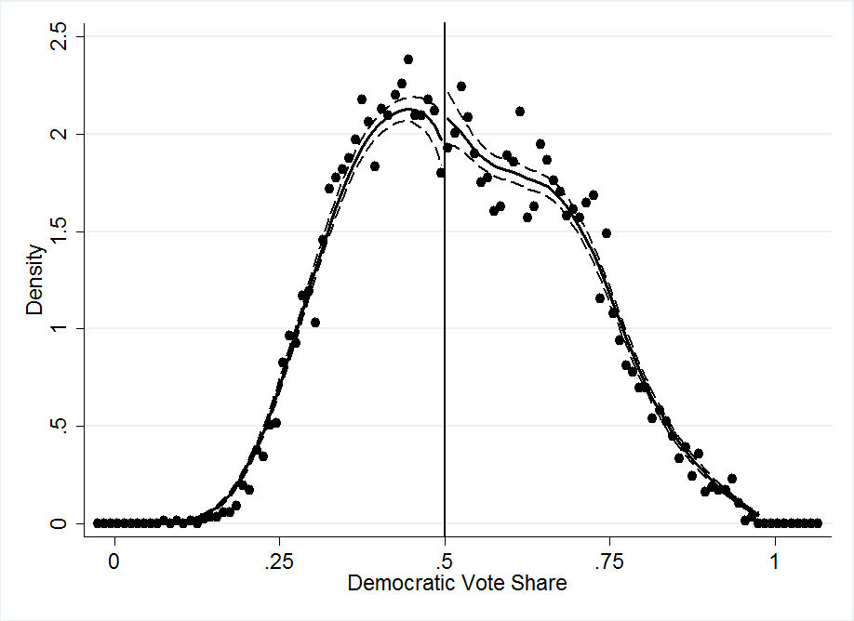
Testing for “Targeting”: Density
Is the density of the treatment variable discontinuous around the threshold? If so, this suggests people are targeting.
Vote shares for democrats should not cluster at 50.1% or 49.9%
In community service example: You would probably have a big cluster of people doing 401 hours (indicating targeting). This would be a clue that your RD was not a “natural experiment”.

Slide 27
Research Design: Instrumental Variables

Slide 28
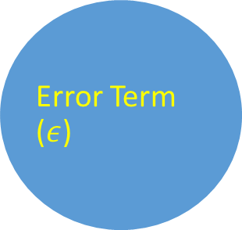

Graphical Depiction of “Natural Experiment” Criteria
$$Y_{i}=X_{i}β+ε_{i} \\ ε_{i}⊥X_{i}$$
Treatment (X)
Outcome (Y)
Treatment may cause the outcome
Error Term ($ε$)
Notes:
example insight from book
airlines leading example

Slide 29
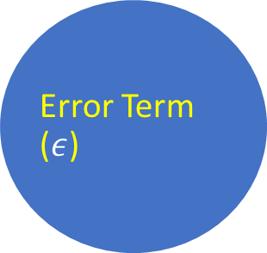
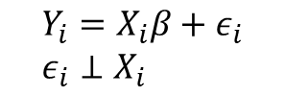
Graphical Depiction of “Natural Experiment” Criteria
$$Y_{i}=X_{i}β+ε_{i} \\ ε_{i}⊥X_{i}$$
Treatment (X)
Outcome (Y)
Error Term ($ε$)
Other unobserved things (error term) can cause Y
Notes:
example insight from book
airlines leading example

Slide 30
Graphical Depiction of “Natural Experiment” Criteria
$$Y_{i}=X_{i}β+ε_{i} \\ ε_{i}⊥X_{i}$$
Treatment (X)
Outcome (Y)
Error Term ($ε$)
Treatment selection can not be caused by the error term
Notes:
example insight from book
airlines leading example

Slide 31

Graphical Depiction of “Natural Experiment” Criteria
$$Y_{i}=X_{i}β+ε_{i} \\ ε_{i}⊥X_{i}$$
Treatment (X)
Outcome (Y)
Error Term ($ε$)
The error term can not be caused by treatment selection
Notes:
example insight from book
airlines leading example

Slide 32
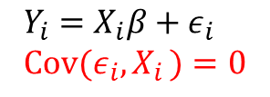
Graphical Depiction of “Natural Experiment” Criteria
$$Y_{i}=X_{i}β+ε_{i} \\ Cov(ε_{i},X_{i })=0$$
Treatment (X)
Outcome (Y)
Error Term ($ε$)
The error term can not be caused by treatment selection
Notes:
example insight from book
airlines leading example

Slide 33
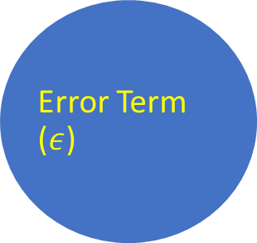
Graphical Depiction of Confounding Variables
Outcome (Y)
This is okay because we observe and control for the confounding variable by putting it in the regression!
Treatment (X)
Confounding Variable (Z)
Error Term ($ε$)
Notes:
example insight from book
airlines leading example

Slide 34
Graphical Depiction of Confounding Variables
Outcome (Y)
This is okay because we observe and control for the confounding variable by putting it in the regression!
But what happens if our confound is unobserved?
Treatment (X)
Confounding Variable (Z)
Error Term ($ε$)
Notes:
example insight from book
airlines leading example

Slide 35
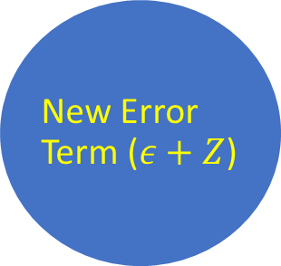
Graphical Depiction of Confounding Variables
This is okay because we observe and control for the confounding variable by putting it in the regression!
But what happens if our confound is unobserved?
It goes into the error term. Not ok!
Treatment (X)
Outcome (Y)
New Error Term ($ε+Z$)
Notes:
example insight from book
airlines leading example

Slide 36
Q: When would I want to use Instrumental Variables? A: When there are unobserved “confounds” that can never be controlled for.

Slide 37
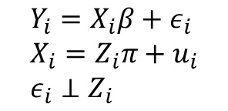

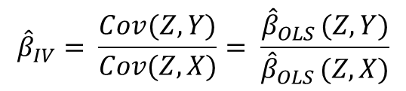
Introducing Instrumental Variables
Instrumental variables are “upstream experiments” that shift (but may not completely determine) treatment.
$$Y_{i}=X_{i}β+ε_{i} \\ X_{i}=Z_{i}π+u_{i} \\ ε_{i}⊥Z_{i}$$
Treatment (X)
Outcome (Y)
How to measure beta?
Effect of Z on Y divided by effect of Z on X!
IV (Z)
Error Term ($ε$)
$${\hat{β}}_{IV}= \frac{Cov(Z,Y)}{Cov(Z,X)}= \frac{{\hat{β}}_{OLS }(Z,Y)}{{\hat{β}}_{OLS }(Z,X)}$$

Slide 38
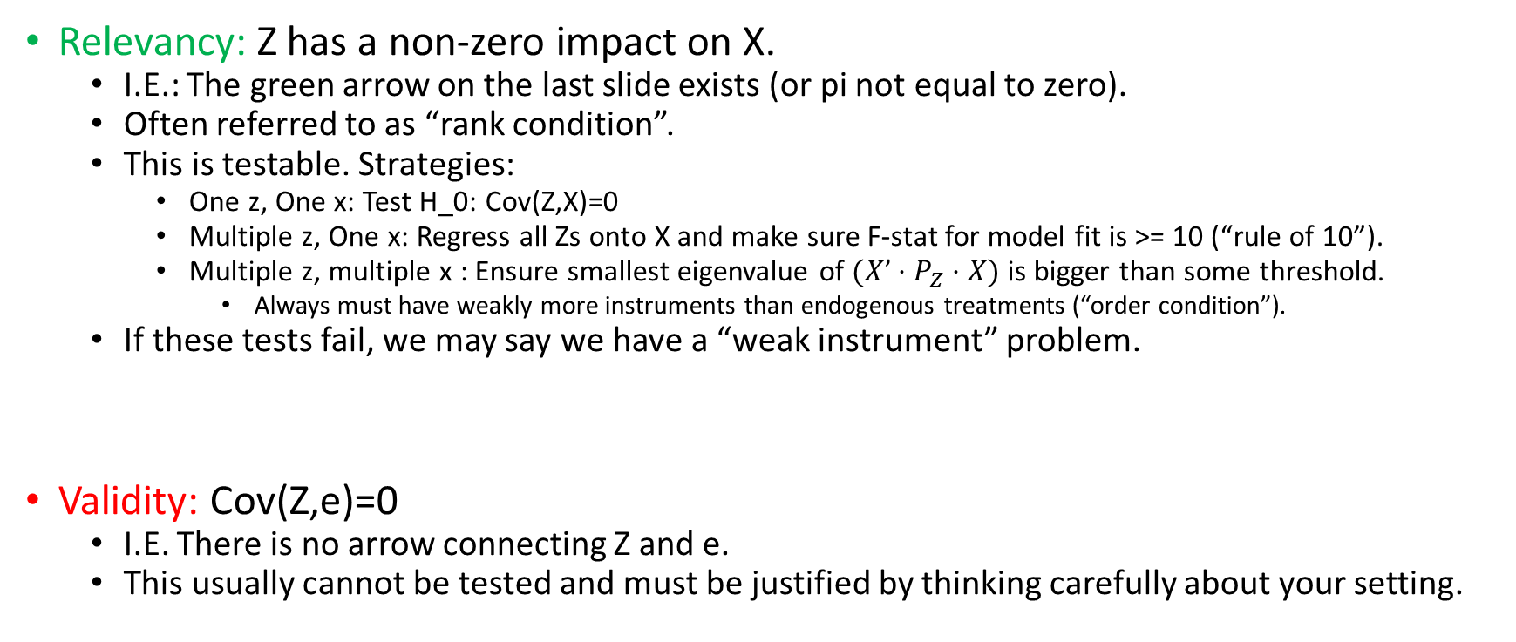
Instrumental Variable Assumptions
Relevancy: Z has a non-zero impact on X.
I.E.: The green arrow on the last slide exists (or pi not equal to zero).
Often referred to as “rank condition”.
This is testable. Strategies:
One z, One x: Test H_0: Cov(Z,X)=0
Multiple z, One x: Regress all Zs onto X and make sure F-stat for model fit is >= 10 (“rule of 10”).
Multiple z, multiple x : Ensure smallest eigenvalue of $(X’⋅P_{Z}⋅X)$is bigger than some threshold.
Always must have weakly more instruments than endogenous treatments (“order condition”).
If these tests fail, we may say we have a “weak instrument” problem.
Validity: Cov(Z,e)=0
I.E. There is no arrow connecting Z and e.
This usually cannot be tested and must be justified by thinking carefully about your setting.

Slide 39
Example: The Vietnam Draft Lottery (Angrist, 1990)

Slide 40
Impact of Military Service On Wages?
“Be all that you can be!” What’s the effect of military service on
lifetime outcomes?
Imagine y = α + β x + ε,
where x is an indicator of service,
y is some outcome measure (wages)
β is the “linear causal effect”
But (x,y) pairs are drawn from nonexperimental data, so Cov(x,ε) ≠ 0
Which way does the bias go?
What is in epsilon: skills, connections, education, work ethic, family connections…
Are those things positively or negatively correlated with decision to join military?
Unclear

Slide 41
The Draft Lottery was a Natural Experiment
Draft lottery over birthdates instituted in 1967 for 1950 birth cohort.
Someone pulled a ball with a birthdate on it from a rotating bin with 365 balls, on national TV. Z=1 if we pulled your ball.
■ z є (0,1) Cov(z, ε) = 0, Cov(z,x) > 0
Everyone with that birthdate was draft eligible, but not all eligibles ended up serving:
Deferments: Bill Clinton/Donald Trump were z=1 but x=0.
Volunteers: John McCain was z=0, x=1.
Conformers: “Draft Dodgers” went to jail if they could not get a deferment. Draft was effective at inducing some additional military service. For folks born in 1950:
P(X=1 | Z=1) = 0.33
P(X=1 | Z=0) = 0.23
How does this information help us learn beta?

Slide 42
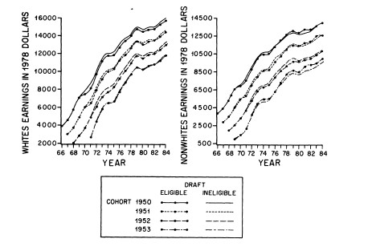
Average Outcome for Eligible vs Ineligible Men
Note: Treatment status (military service) is not used at all in making this graph!

Slide 43
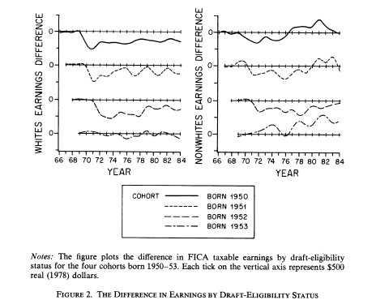
Differences in Earnings w/ trend
removed [Reduced Form]
Eligible Whites (left plot) consistently earned less money over the course of their life than ineligible whites.
Eligibility determined only by birthdate. Why should birthdate impact earnings?
It probably shouldn’t! This is evidence that military service is hurting lifetime earnings for whites.

Slide 44

Effect Size
Suppose: Eligible men (z=1) earn on average $200 less per year over the course of their lifetime than ineligible men (z=0).
Recall: Eligible men (z=1) are 10% more likely to serve than ineligible men (z=0):
P(X=1 | Z=1) = 0.33
P(X=1 | Z=0) = 0.23
So how do we use this to estimate beta?
Denominator is impact of x on z: So if the effect of z on y ($200) is fixed, but the effect of z on x (.1) gets smaller: then we have to conclude that the causal effect of x on y must be larger!
Why does this logic work? Validity: the only way z can impact y is through x! If the number of people effects is smaller and the total impact is the same, then the per person impact must also be larger!
What happens as impact of z on x goes to zero? Answer: Failure of relevancy: Natural experiment is meaningless, standard errors on estimate go to infinity.
${\hat{β}}_{IV}= \frac{Cov(Z,Y)}{Cov(Z,X)}= \frac{{\hat{β}}_{OLS }(Z,Y)}{{\hat{β}}_{OLS }(Z,X)}=\frac{\$200}{.1}=\$2,000$

